Slide 1
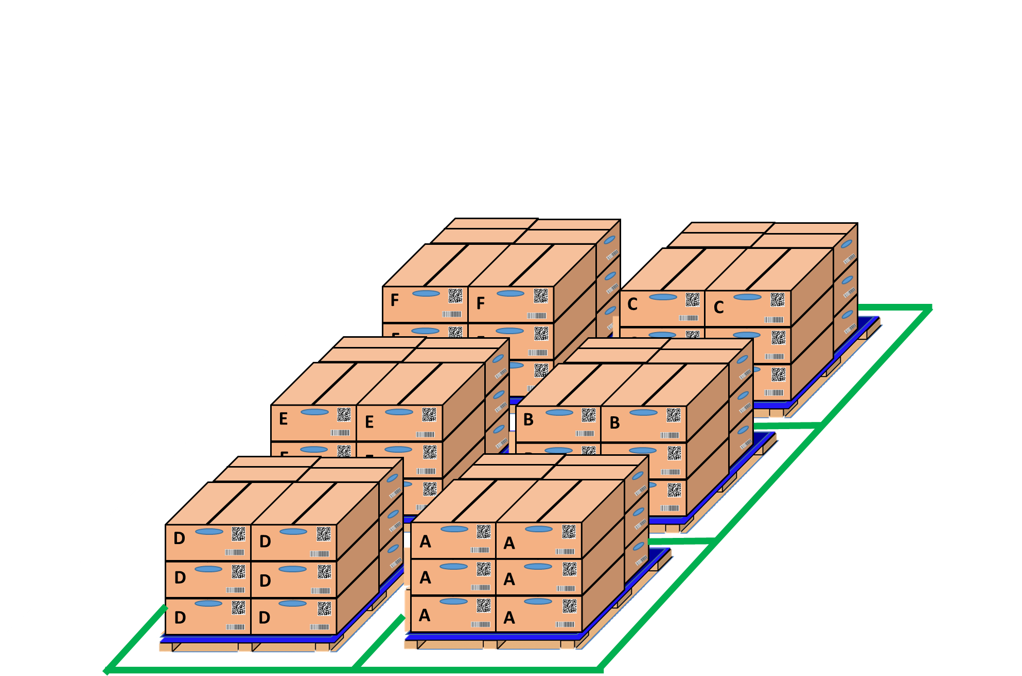




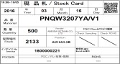




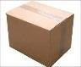





Activity 1: Electronic standardization of stamps for IQC departments
Control process get sample at IQC area
Vendor
MCS Receiving Goods
MCS Fix location
IQC check & chop stamp
MCS Find OK /NG part
Step 5:Storing
Scan GR
Separate non-inspection & inspection
Non-inspection
Inspection
Moving part to rack for Storing
Inspection
Find Part OK / NG to storing
Inspection
Inspection
MCS
MCS
OK
Inspection
NG
Fix
location
OK
OK
NG
MCS
Day- Month- Year
Day- Month- Year
IQC chop stamp only one receiving card
PQC
PQC
OK
NG
IQC chop stamp all lot
-Get sample
-Or direct checking
by table
Day- Month- Year
Day- Month- Year
PQC
PQC
PQC
PQC – Inspection team
PQC – RoHS team
Normal inspection ( Non-issue out )
Reliability testing ( Issue out )
1. Auto input the all data of part need check RoHS into SAP ( ZQV011,14,15,17** ) by click website.
2. Auto deduct Quantity on SAP after confirmed Quantity need take to test RoHS.
Confirm part ➔ Auto input the part situation on the system and start inspection by select part
Use tablet to confirm part need test alcohol, tape, function… by select part
Open the drawing & WI on Tablet to direct inspection
Move other part into PQC room to inspection
Manual deduct Quantity on SAP and make Transfer report to MCS.
Move part into PQC-RoHS room to analyse
Confirm result OK/NG lot by click on website
Confirm result checked lot by Click OK/NG indicate on website

Slide 2
Activity 1: Electronic standardization of stamps for IQC departments
1. IQC Inspection & chop stamp procedure
Inspection Normal
OK / NG
Chop stamp all lot
Loss time
Part incoming
Waiting area
Chop stamp get sample
Loss time
Inspection ROHS
OK / NG
Chop stamp one receiving card
Loss time
OK
Storing
NG
Print part card
Scan barcode
Auto deduct Quantity on SAP
Kho MCS OK
Kho NG
Test alcohol, tape, function
OK / NG
Not chop stamp
2. IQC Inspection recheck, more 1 Year
Kho MCS OK
IQC room
Inspection recheck
NG
Chop stamp
Loss time
Kho NG
Chop stamp
Loss time
OK
3. IQC Inspection recheck SMT warehouse more 1 year
Part incoming
Non inspection
Kho SMT OK
IQC room
Inspection recheck
NG
Chop stamp
Loss time
Kho NG
Chop stamp
Loss time
OK

Slide 3



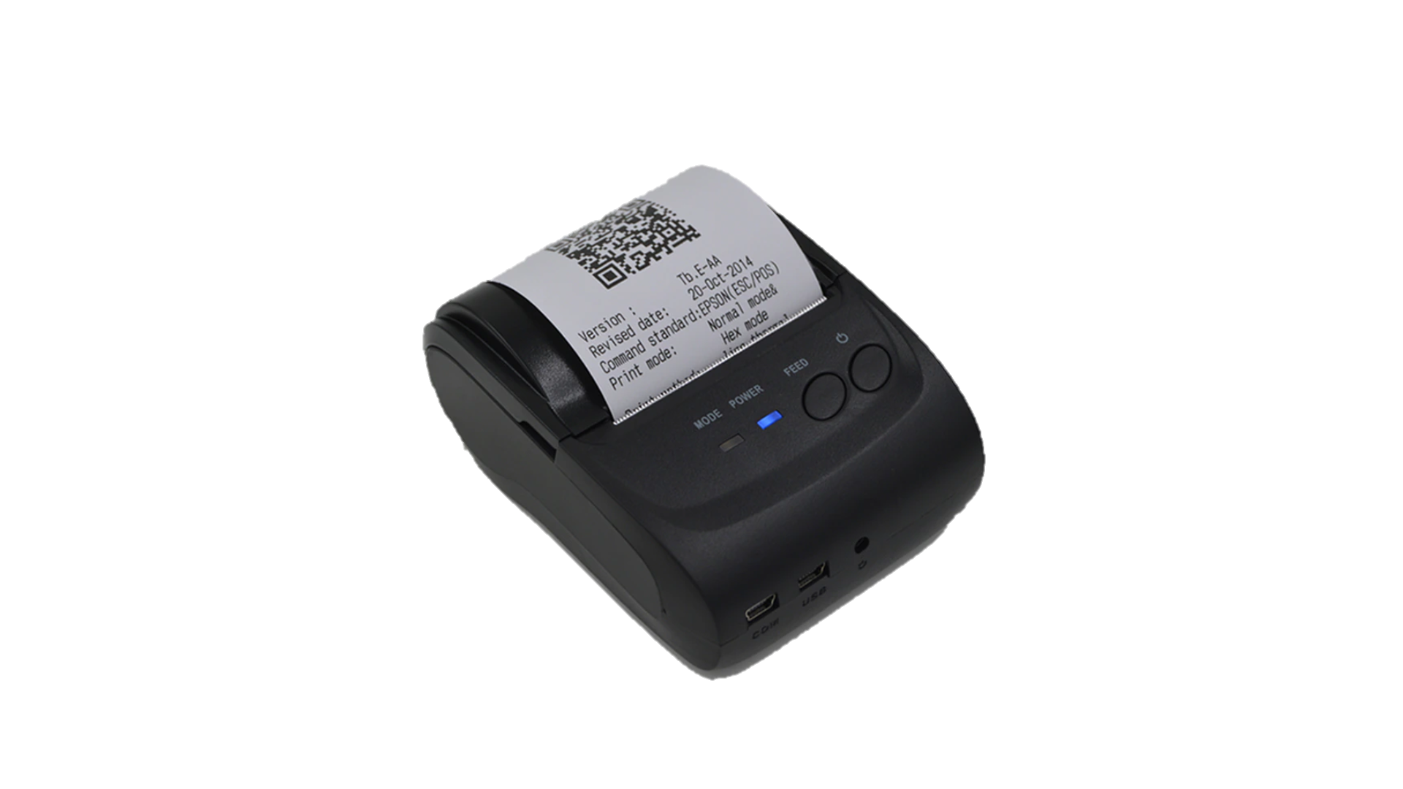
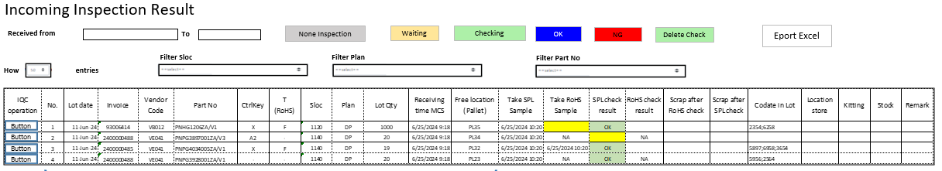
Activity 1: Electronic standardization of stamps for IQC departments
Improvement Stamp
PQC
Sampling
No need stamp
Inspection
Warehouse MCS
Non-inspection
Storing
Inspection
IQC pick up sample
OK
NG
IQC inspection
OK
NG
MCS check status Inspection
OK
OK
Store
OK
No need stamp
Recheck, more 1 Year
SWMS
Day- Month- Year
PQC
MCS
MCS print Receiving card
Print recheck card
QC Room
OK
NG
Visualize Inspection IQC
OK
IQC
IQC inspection recheck
IQC can traceability and export daily

Slide 4
Activity 1: Electronic standardization of stamps for IQC departments
Summary Merit if IQC no chop stamp on actual Pallet & Box/ Hopper
Item | Detail | Unit | No | Before |  |  |  | After
 |  |  |  | PL part | Electric Part | Mecanical part | RoHS | PL part | Electric Part | Mecanical part | RoHS
Incoming lot | Average number of lots coming in a month (inspection) | Lot | (1) | 507 | 369 | 2681 | 960 | 507 | 369 | 2681 | 960
 | Average number of pallets / 1 Lot incoming | Palet | (2) | 3 | 3 | 3 | 3 | 3 | 3 | 3 | 3
 | Average number of boxes, hoppers/ 1 Pallet | Box | (3) | 15 | 13 | 5 | 7 | 15 | 13 | 5 | 7
Time for chop stamp | Time to move and stamp OK/NG for 1 receiving card/1 Pallet (seconds) | Second | (4) | 10 | 10 | 10 | 10
 | Time check stamp for 1 box (seconds) | Second | (5) | 10 | 5 | 5 | -
 | Date Code / Batch Time Record (seconds) | Second | (6) | 180 | 45 | 45 | - | 180 | 45 | 45 | -
 | Time to move to warehouse for return and stamping/ 1 Lot | Second | (7) | 120 | 120 | 120 | 120 | 120 | 120 | 120 | 120
 | Total time / Lot = (4*2)+(5*3*2)+(6) +(7) (second) | Second | (8) | 780 | 390 | 270 | 150 | 300 | 165 | 165 | 120
Total Time / month = 8*1 (Hours) |  | Second | (9) | 395,460 | 143,910 | 723,870 | 144,000 | 152,100 | 60,885 | 442,365 | 115,200
Different (Hours) |  | Hour |  | 391 |  |  |  | 214
 |  |  |  | 177
Final summary
Working time 1 pax / 1Month | 192 | Hours
Can save time if delete chop stamp | 177 | Hours
Save manpower / month | 0.92 | Pax

Slide 5

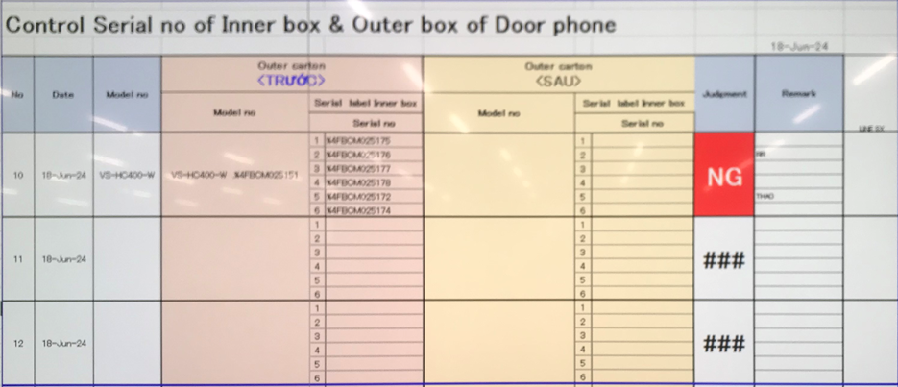
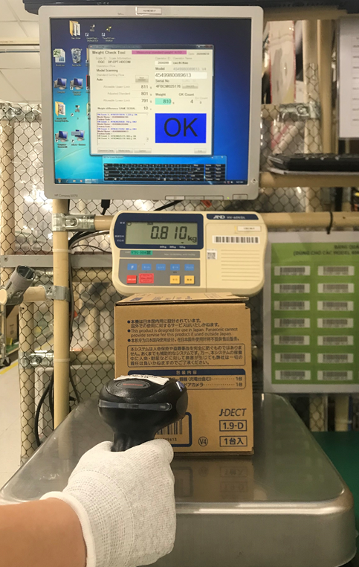
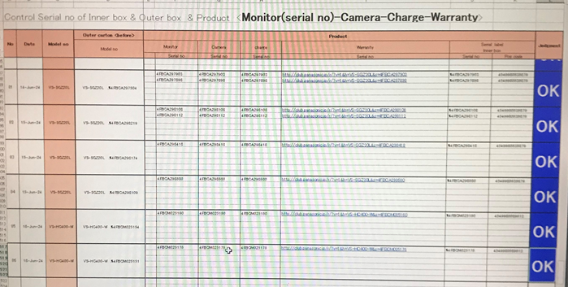
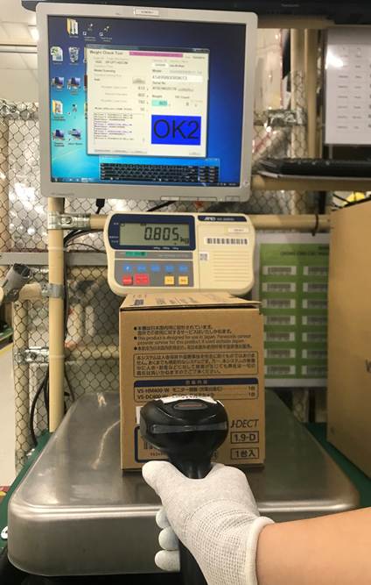
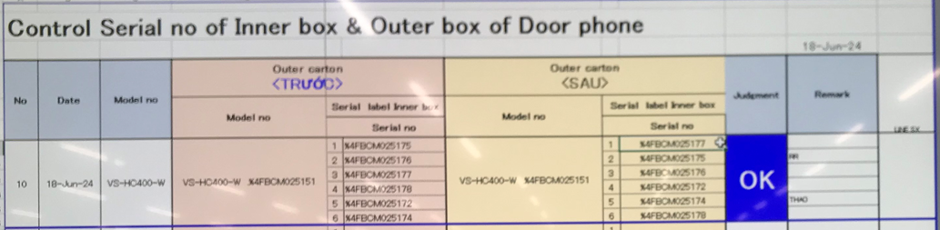
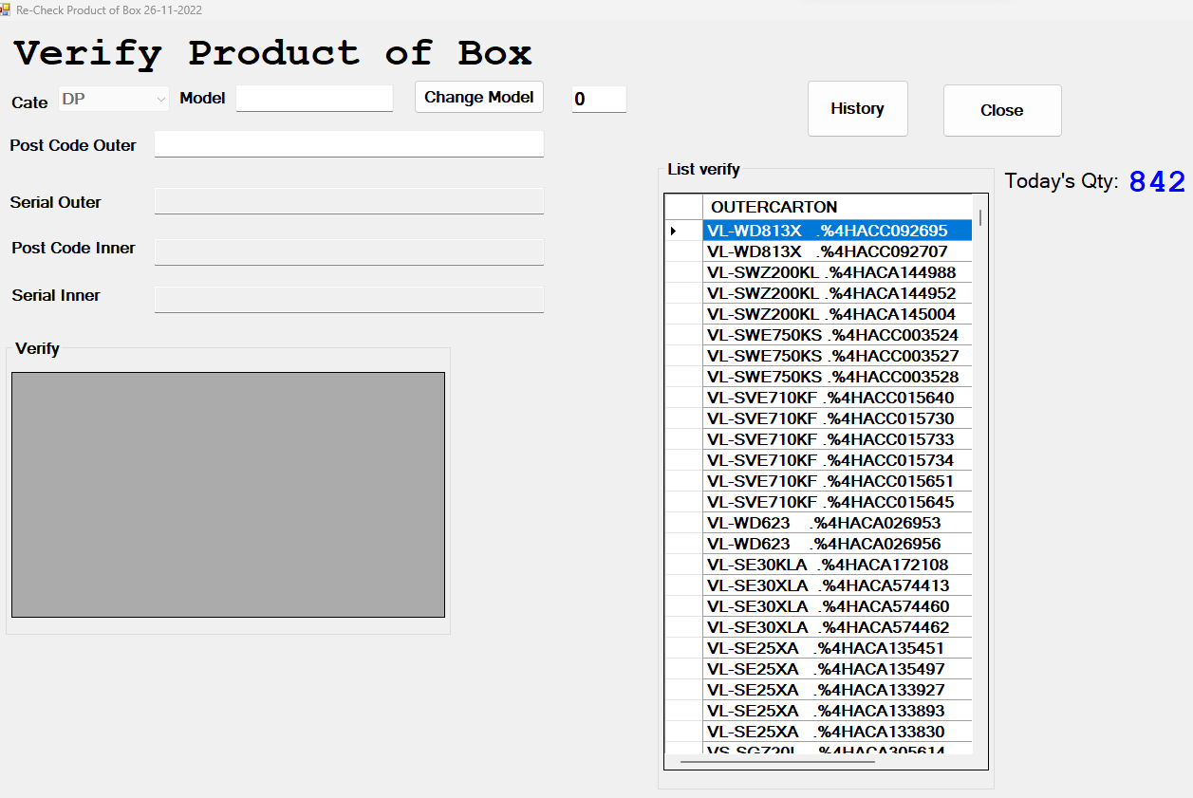



Activity 2 : Link Weight Check System FA-SCM-OQC
Control process sample at OQC area
Pick up sample
Reading barcode Inner/Outer excel file
Weight check 1st
OQC
inspection
Reading BC
Product/Inner excel file
Weight check 2nd
Reading barcode
Inner/Outer excel file
Return to Pallet
No Link
No Link
No Link
Reliability
No Link
No Link
No Link
No Link
Production Line
Confirm S/N Outer & all inner boxes
Accessory control
Numbering control & Separate area
Product / Warranty/ Manual & Inner box
Accessory control
Confirm S/N Outer & all inner boxes
Warehouse FA
Improvement
Get sample by Mobile
Scan barcode Inner/Outer by new software
Weight check 1st
OQC
inspection
Reading BC inspection result by new software
Weight check 2nd
Scan barcode Inner/Outer by new software
Return to Pallet by mobile
Reliability
Production Line
Confirm S/N Outer & all inner boxes
Accessory control
Numbering control & Separate area
Product / Warranty/ Manual & Inner box
Accessory control
Confirm S/N Outer & all inner boxes
Warehouse FA
Database server

Slide 6

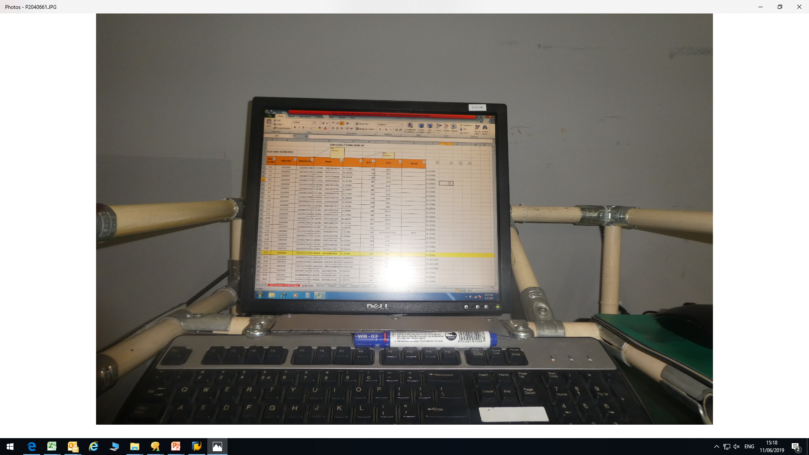

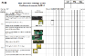
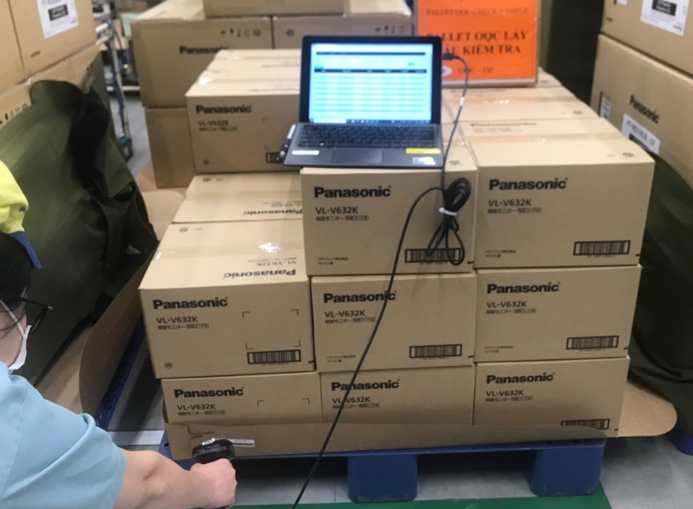



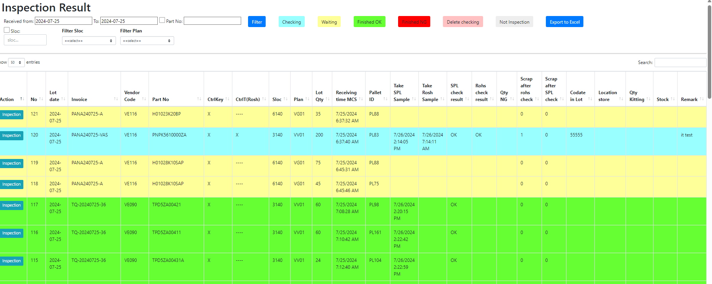
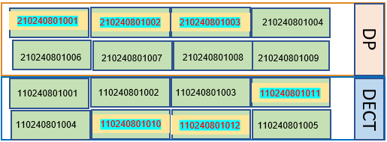

Activity 2 : Link Weight Check System FA-SCM-OQC
E chop for OQC inspection
Line 1A
OQC Inspection
Line 2A
Weight check 1
Scan serial outer / inner the first
OQC inspection
Scan serial outer / inner the second
Weight check 2
Input inspection result on excel file
OQC inspection result
Line 3A
OK
NG
OQC member pick up sample
Chop stamp Process
Line 4A
Recode ID Pallet & S/N carton box by excel file
Find all same model, production date, line, shift
Line 5A
OQC find Pallet ID
Matching ID Pallet and Outer Carton
OQC chop stamp all ID Pallet
OK
NG
location
OQC
Database server
Production line
Day- Month- Year
New system link FA-SCM-OQC
E – chop can
replace
Auto judgment OK for
All pallet ID the same Model, production date, line and shift.
FA
Link
OQC
Link
SCM
Shrink machine
Visualize OQC inspection
OK
OQC return sample
FA shrink pallet ID
FA fix location
Day- Month- Year
OQC
DP area
DECT area
SCM Warehouse
SCM Out location
Visualize FA Warehouse area
WMS system
Shipping To market

Slide 7
Activity 2: Link weight check system FA-SCM-OQC
◆Before
◆ After
FA
OQC
SCM
FA
Link
OQC
Link
SCM
No indicate shipment priority
No indicate result timely
Cannot use weight system → compare S/N by manual
Update OQC result not timely.
Loss time to come to SCM for chop stamp.
Loss time to confirm stamp by visual check
Indicate result timely
Indicate shipment priority
Use weight system → auto compare S/N
Online update OQC result & Save time to come to SCM for chop stamp
No need check stamp by visual
Confirm OQC result by system
Target improve:
Prevent wrong packing leakage out to market
△ 2pax for stamp by manual
2pax
OQC Issue
Risky point : Wrong packing pass to market by control offline
Loss time to confirm production result & Shipment schedule : 90sec*150 lots=3.75H/day.
2pax/ day need to follow chop stamp in warehouse.
Improvement: Link system from FA-OQC-SCM
Prevent wrong packing.
Save time : 3.75H/day ~ 990H/year
Save manpower : △ 2pax for stamp ~ 12K$/ year

Slide 8
Activity 2: Link Weight Check System FA-SCM-OQC
FA
Pallet ID
SCM
Shipment
- Save Weight Check Date
on server : Production
Date/Model/Q’ty
- Issue Pallet ID: Model/Q’ty/SN
- Issue Movement slip <SAP>
- Read Pallet ID Model/Q’ty
- Compare FG & WMS
- Read Pallet: <Model/Q’ty>
- Compare FG & WMS
CURRENT SITUATION
OQC
- Pick up sampling
inspection
Additional
Additional
Additional
Additional
① Add OQC :
Input sampling plan
Input Sampling product & Serial No
② Indication OQC situation:
Input Checking result
Input Final judgment All lot.
→ Send result by Email auto
③ QC inspection result:
Reading Pallet ID to check OQC result
Indicate OK lot
④ Function: If OQC judgment NG or Not yet
Stop next step
< PSNV/ Jupiter >
Study to link weight check & WMS
REQUEST
MERIT
Save:
8,000min/month
Save:
Reduce 2pax
990H/year
Save:
4,000 min/month
Note: In case the model have not Serial Number → They should be controlled as current method

Slide 9
Issue Job And Schedule To Complete
 |  | 2024 |  |  |  |  |  | 2025
No | Detail Function | Jul | Aug | Sep | Oct | Nov | Dec | Jan | Feb | Mar
Issue 1 | IQC Normal & ROHS inspection on website
 | IQC Normal & ROHS inspection on mobile
 | IQC Recheck inspection on web & mobile
 | IQC 1 Year inspection on web & mobile
 | Show inspection status on mobile
 | Find material location quickly on mobile
Issue 2 | Pick up & return sample for OQC
 | Compare serial outer & inner boxes
 | Link weight OQC with weight FA
 | Input checking OQC result auto judgment all lot for production result in day
 | Auto link inspection result OQC for SCM
 | Visualize inspection result OQC,FA & SCM
Plan
Actual
Go-live

Slide 10
Issue Job And Schedule To Complete
 |  | 2024 |  |  |  |  | 2025
No | Detail Function | Aug | Sep | Oct | Nov | Dec | Jan | Feb | Mar
Issue 1 | Pick up & return sample for OQC
 | Compare serial outer & inner boxes
 | Link weight OQC with weight FA
Issue 2 | Input checking OQC result auto judgment all lot for production result in day
 | Auto link inspection result OQC for SCM
 | Visualize inspection result OQC,FA & SCM
Plan
Actual
Go-live

Slide 11
Issue Job And Schedule To Complete
 |  | 2024 |  |  |  |  | 2025 |  |  | Target
No | Detail Function | Aug | Sep | Oct | Nov | Dec | Jan | Feb | Mar
Issue 1 | Pick up & return sample for OQC |  |  |  |  |  |  |  |  | Reduce manual Job Save time and Ensure Quality
 | Compare serial outer & inner boxes
 | Link weight OQC with weight FA
Issue 2 | Input checking OQC result auto judgment all lot for production result in day |  |  |  |  |  |  |  |  | Reduce 2pax for stamp by manual
 | Auto link inspection result OQC for SCM
 | Visualize inspection result OQC,FA & SCM
Plan
Actual
Go-live

Slide 12
Issue Job And Schedule To Complete
 |  | 2024 |  |  |  |  | 2025 |  |  | Target
No | Detail Function | Aug | Sep | Oct | Nov | Dec | Jan | Feb | Mar
Issue 1 | Pick up & return sample for OQC |  |  |  |  |  |  |  |  | Reduce manual Job Save time and Ensure Quality
 | Compare serial outer & inner boxes
 | Link weight OQC with weight FA
Issue 2 | Input checking OQC result auto judgment all lot for production result in day |  |  |  |  |  |  |  |  | Reduce 2pax for stamp by manual
 | Auto link inspection result OQC for SCM
 | Visualize inspection result OQC,FA & SCM
Plan
Actual
Go-live
Analysis, Discuss
Standardize, Develop
Discuss, Develop
Develop
Testing, Training
Analysis, Discuss, Standardize
Discuss, Develop
Testing, Training

Slide 13
Issue Job And Schedule To Complete
 |  | 2025 |  |  |  |  |  |  |  |  | 2026
No | Activities | Apr | May | Jun | Jul | Aug | Sep | Oct | Nov | Dec | Jan | Feb | Mar
Job develop
1
2
For myself
3 | Improve my skills such as communication skills, presentation skills and reporting skills
4 | Take part in English course (from GA)
For my team
5 | Support training and make plans for the manager and control KPI to keep on time
6 | Sharing experiences, training support skills, and improving team spirit

Slide 14
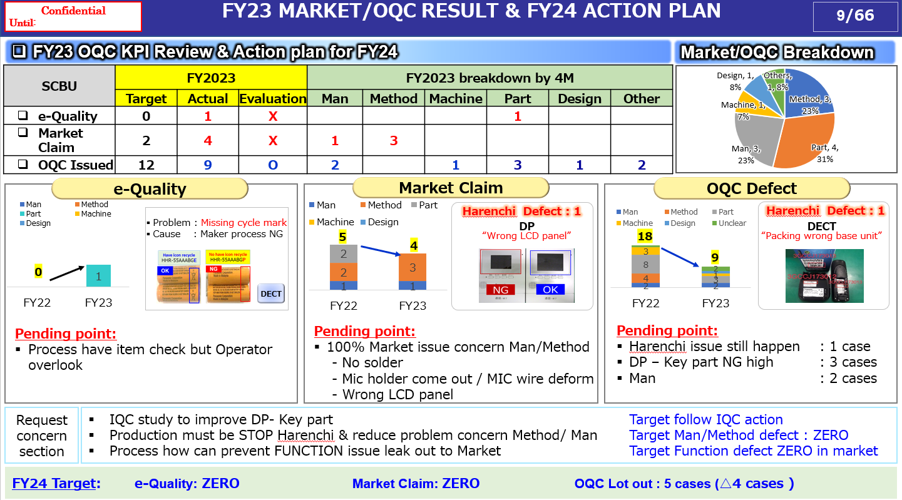

Slide 15
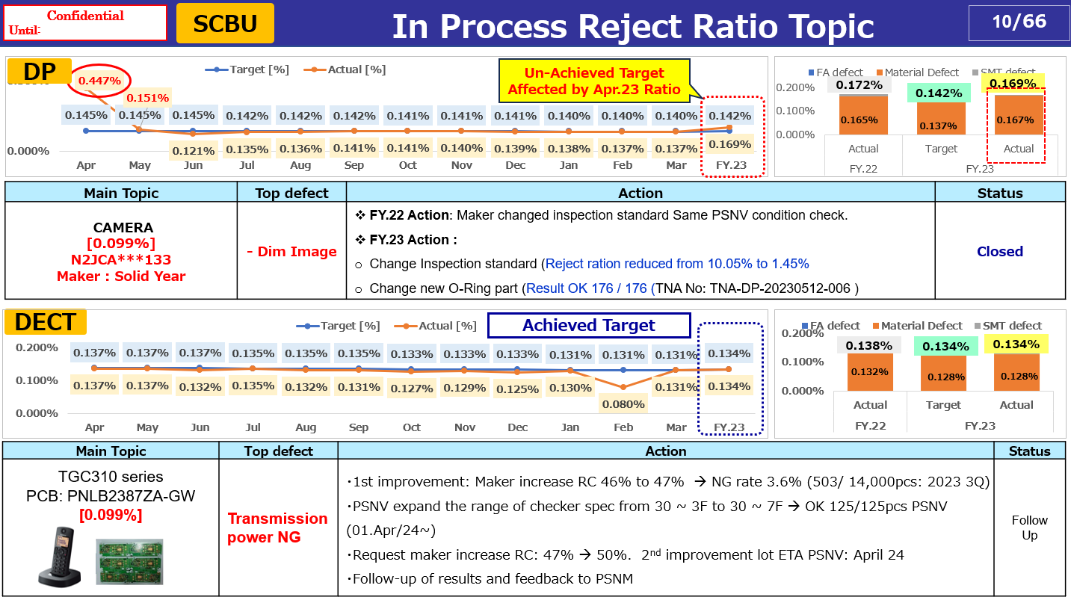

Slide 16
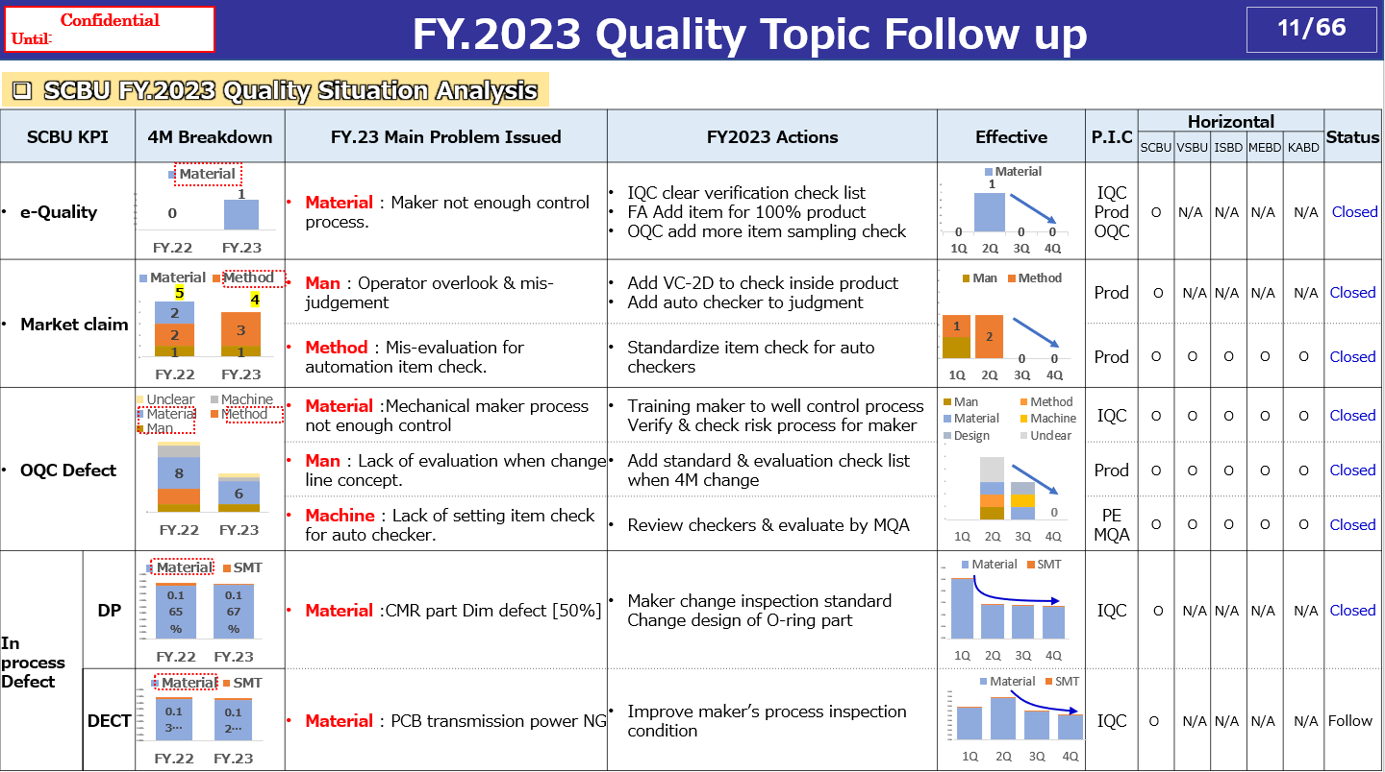

Slide 17
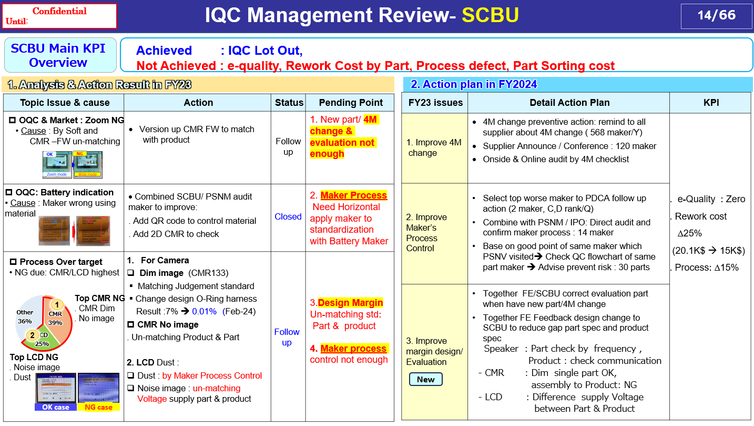

Slide 18
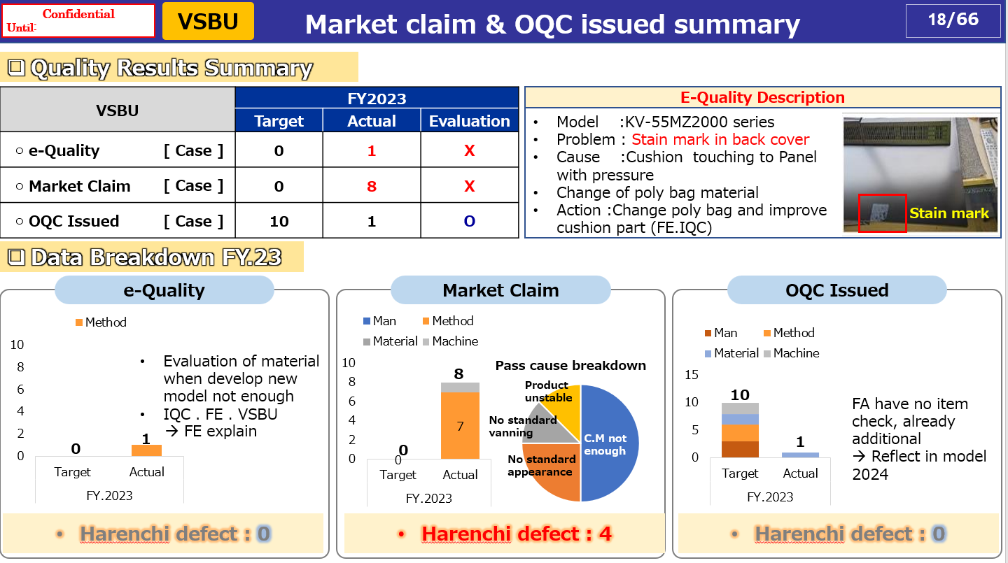

Slide 19
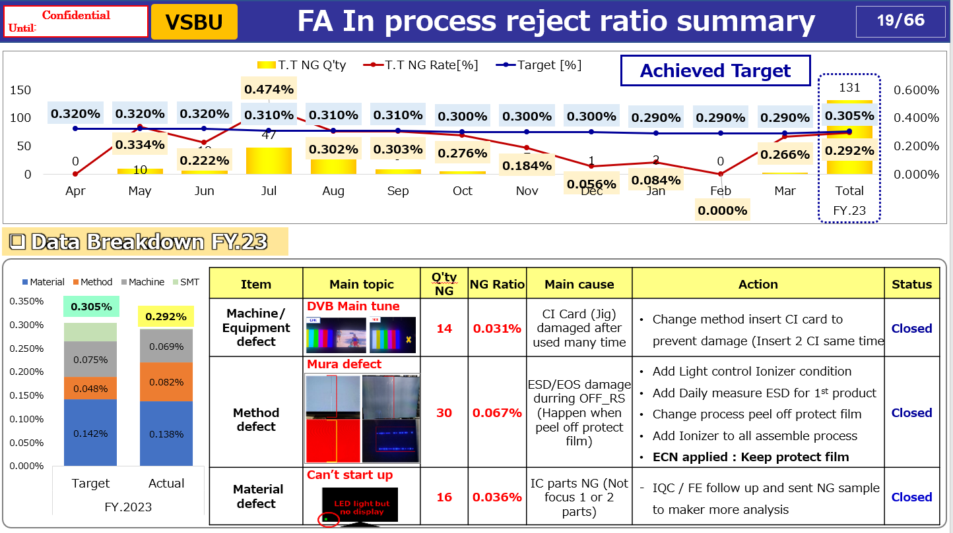

Slide 20
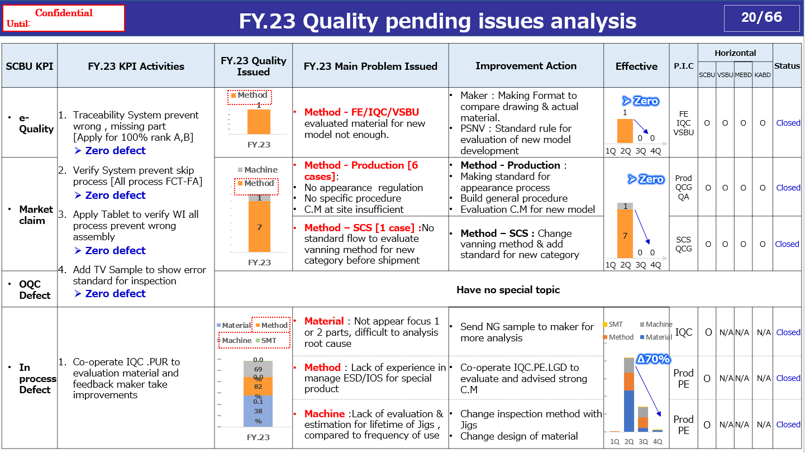

Slide 21
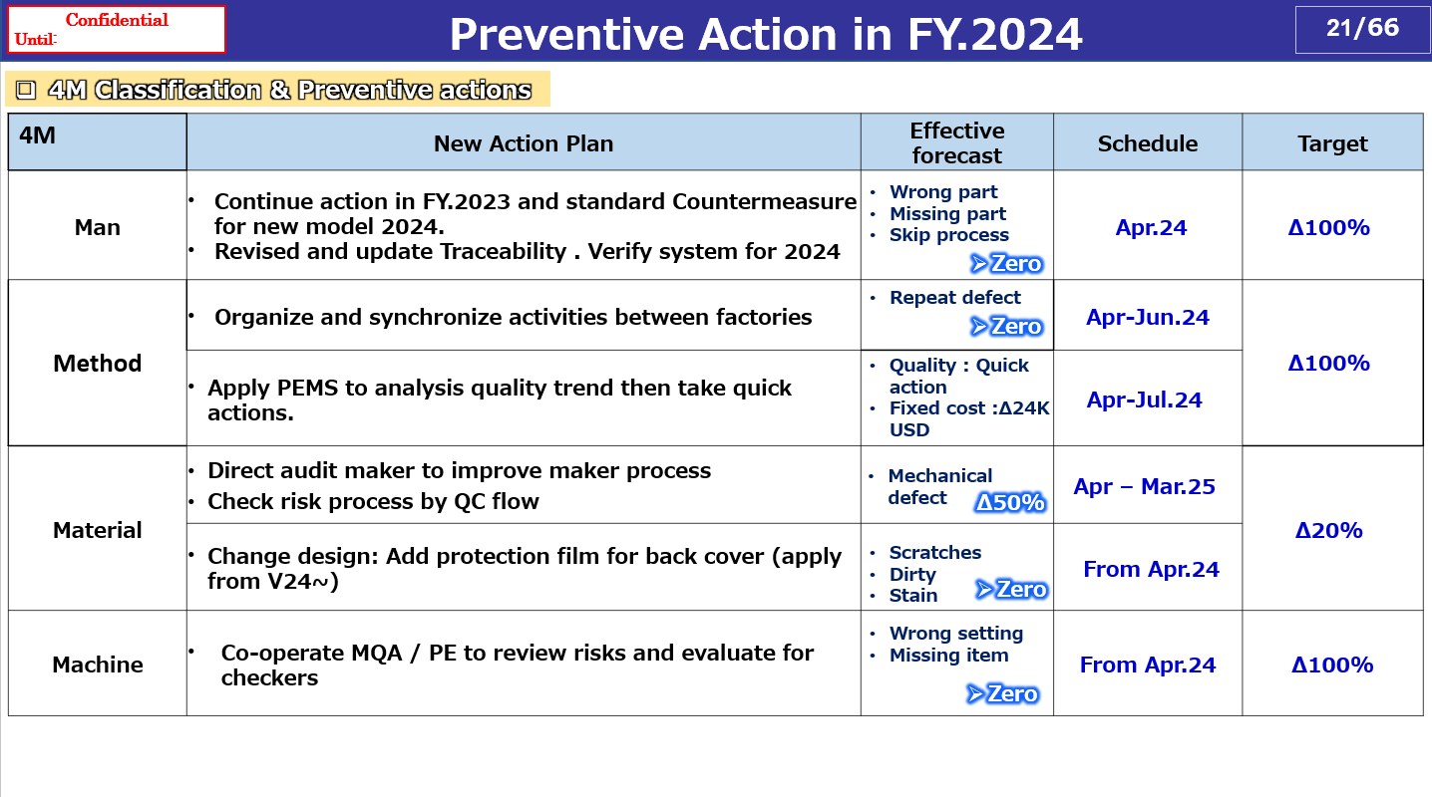

Slide 22
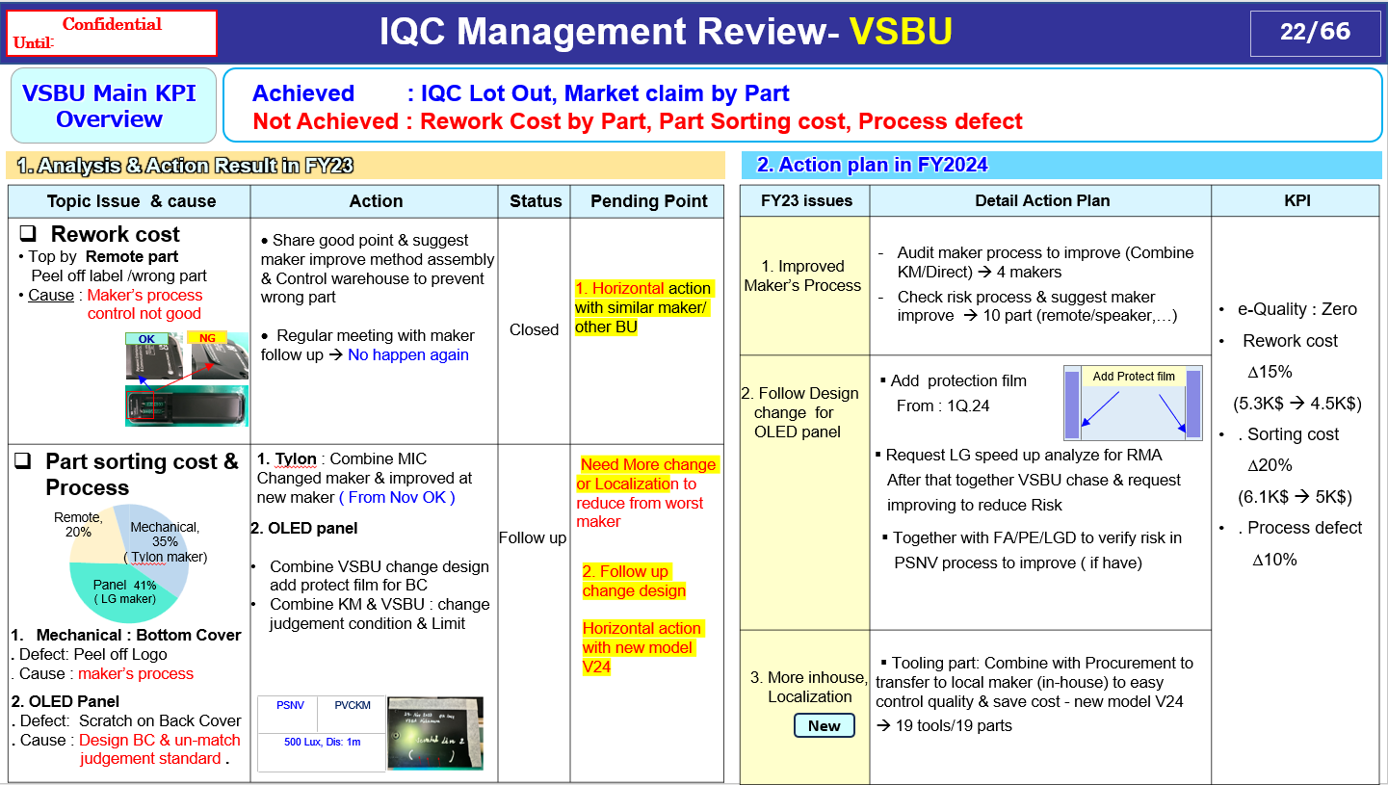

Slide 23














Cost
Time/Man
Opportunities

